Slide 1
EVs for Disasters in Action
11-12 June 2015, Bari-Italy
Societal Benefit Area: Disasters
Name(s): Jane E. Rovins, PhD, CEM
Institution: DRR Solutions, LLC
Coordinating an Observation Network of Networks EnCompassing saTellite and IN-situ to fill the Gaps in European Observations

Slide 2
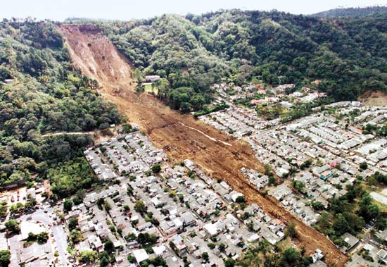
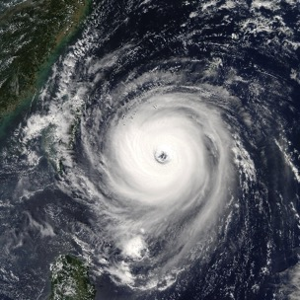
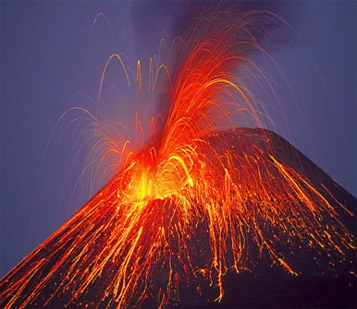
Hazards vs. Disasters

Slide 3
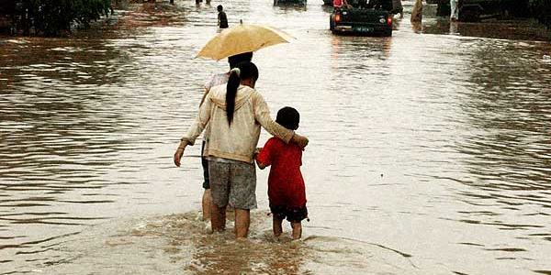
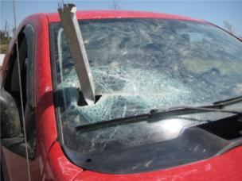
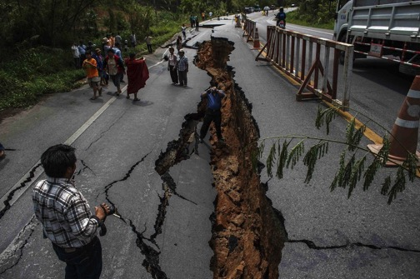
Disaster are about PEOPLE

Slide 4
Disaster Risk Management (DRM)
DRM
DRR
DM
Prevention
Mitigation
Preparedness
Response
Recovery

Slide 5
Who is your Stakeholder?
Government Agencies
Communities
Academia, researchers and scientists
Non-Governmental Organizations (National and International)
Private Sector
Media
Other Stakeholders

Slide 6
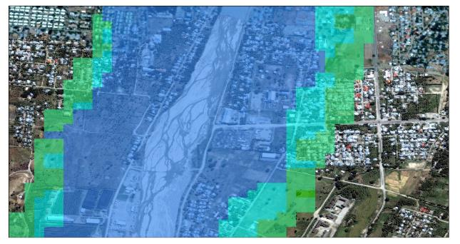
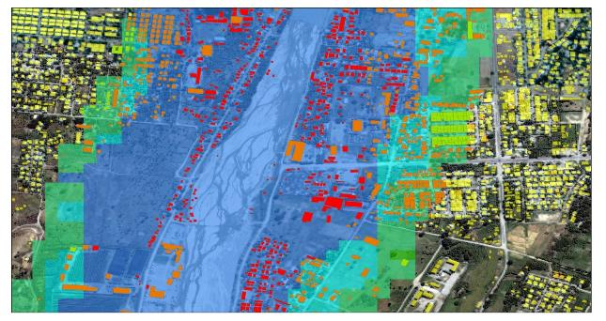
Hazard vs. Risk
Flood Hazard Map
Flood Risk Map

Slide 7
Sendai Framework Targets
Reduce global disaster mortality by 2030
Reduce the number of affected people globally by 2030…
Reduce direct disaster economic loss in relation to global GDP by 2030.
Reduce disaster damage to critical infrastructure and disruption of basic services…
Increase the number of countries with national & local DRR strategies by 2020.
Enhance international cooperation…for implementation of this framework by 2030.
Increase the availability of and access to multi-hazard early warning systems, disaster risk information and assessments…

Slide 8
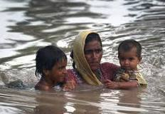
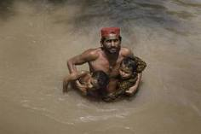
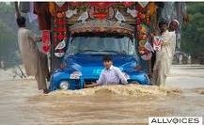
Status of existing EVs in the domain
Primary Human Impact Indicators
Secondary & Tertiary Human Indicators
Economic Loss Indicators
All the sector specific variables……

Slide 9
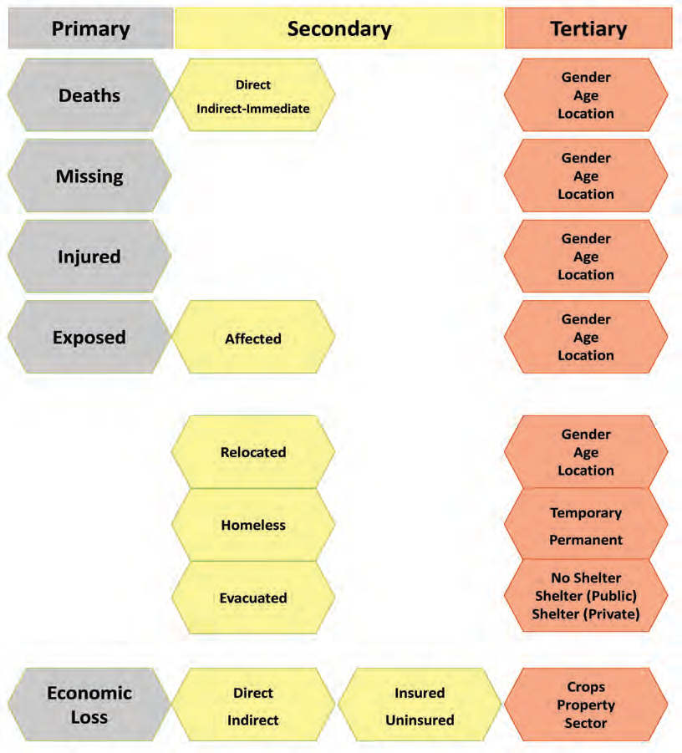
Notes:
IRDR Data Report No. 2

Slide 10
Describing the monitoring networks currently operational
3 Global Losses databases
CRED EM-DAT
Munich Re NatCat SERVICE
Swiss Re Sigma
55 National loss databases
Most based on DesInventar model, with UNISDR support

Slide 11
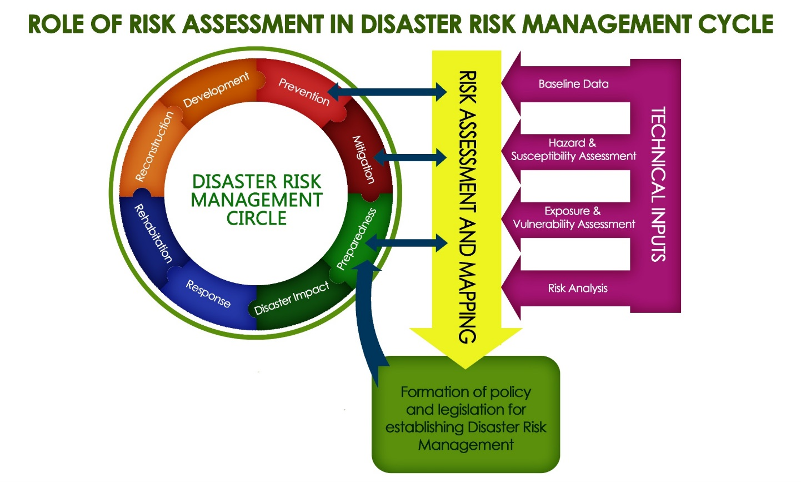
Disaster Risk Assessment Model

Slide 12
Technical Inputs

Slide 13
Assessing EV observational needs and readiness
Stakeholders
Issues of sustainability
Long-term maintenance
Varying quality
Revolving numbers
Limited down-scaling to sub-national level
Bias

Slide 14
Biases in Loss Databases Remain
Hazard bias – every hazard type is represented
Temporal bias – losses are comparable over time
Threshold bias –all losses regardless of sie are counted
Accounting bias – all types of losses included (monetary, human, direct, insured, uninsured)
Geographic bias – hazard losses are comparable across geographic unites, boundaries not change
Systemic bias – losses recorded are the same regardless of source

Slide 16
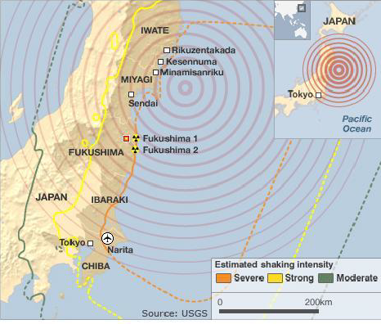
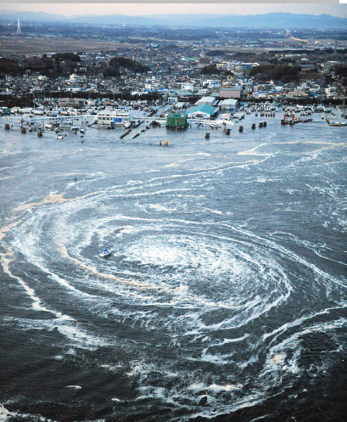
The Great East Japan Earthquake and Tsunmani (March 2011)
Earthquake Tsunami Nuclear Power Stations

Slide 17
Essential Variable Interaction

Slide 18
What is needed?
Increased downscaling of data to sub-national geographies
Education of users regarding data bias and issues of social loss data
Comparable and accessible human disaster loss data to support research, policy and practice
Clearer methodology of what is a loss and how to assess it
Acceptance and understanding of disasters as trans-disciplinary

Slide 19
Conclusions
Climate
change
Health
Disaster Risk
Management
Poverty
Education
Sustainable
Development
Environ
…

Slide 20
Thank you
Jane.rovins@gmail.com
@DRRSolutions

